Slide 1
Eco-friendly Zero Energy Building Environment and Utility System Technology
Sahghoon Park
Korea Institute of Civil Engineering and Building Technology

Slide 2
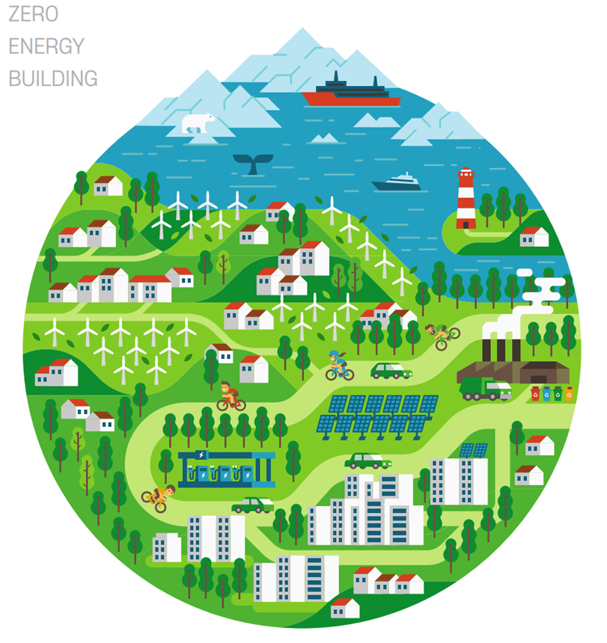
Contents
Eco-friendly Zero Energy Building Environment and Utility System Technology
1. Introduction
What is Eco-friendly and ZEB(Zero Energy Building)?
2. Low/Zero Energy Building Planning
Conventional building design process
ZEB planning and design process
3. ZEB Technology
Passive environmental building control technology
Active environmental building control technology
New & Renewable energy
BEMS(Building Energy Management System)
4. Simplified Building Simulation Method for ZEB
Window and Wall simulation
Building energy simulation
5. Building Code and Certification for ZEB
6. Case study

Slide 3
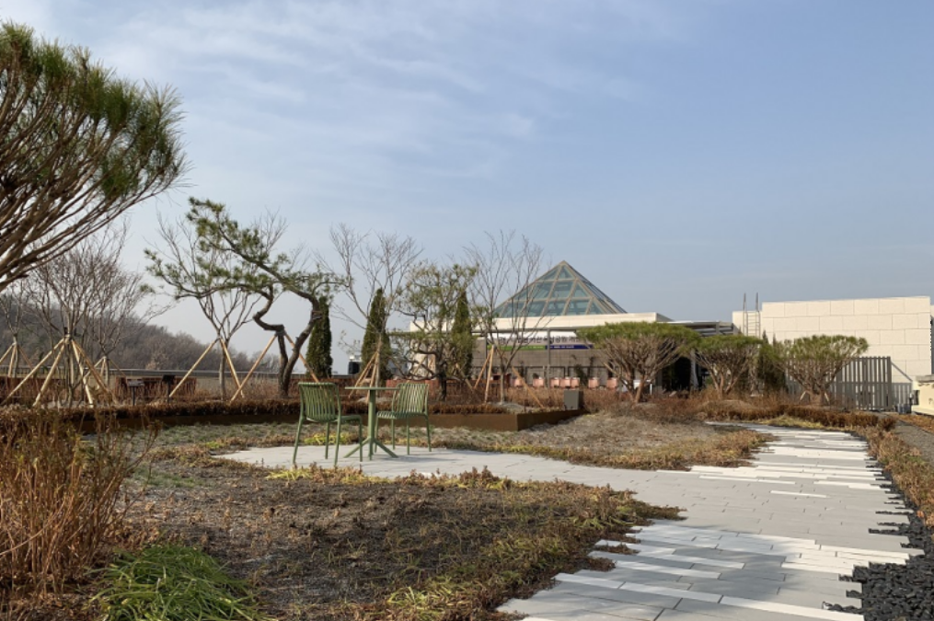
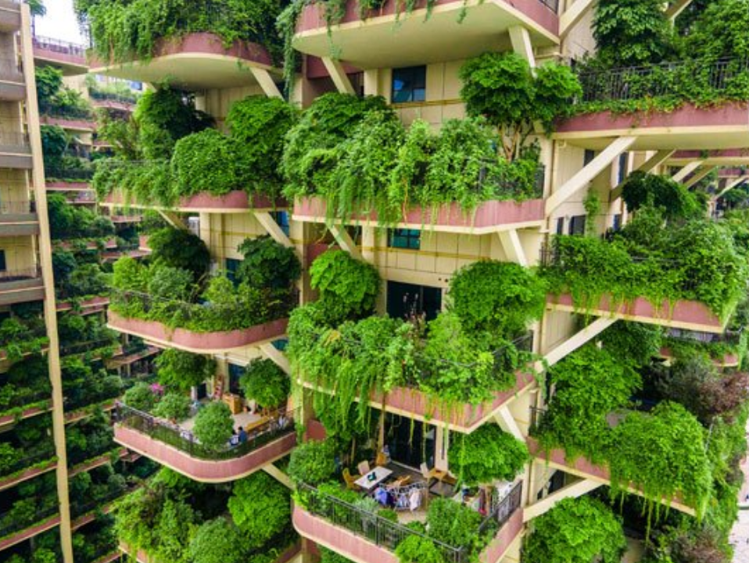
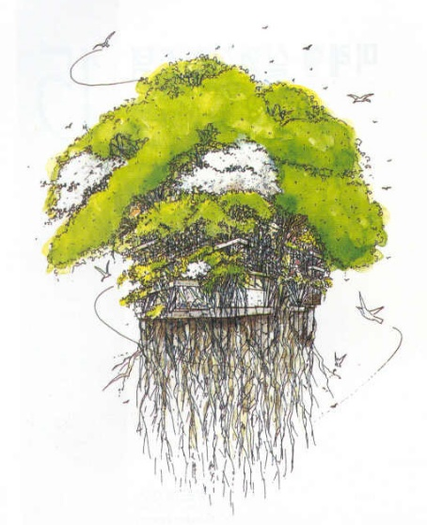
Introduction
What is Eco-friendly and Zero Energy Building?
What image comes to mind when you first think of an eco-friendly building?
A green planted building
Green Roof(Rooftop gardening): The Supreme Court of the Republic of Korea (located in Seocho-gu, Seoul) created a 2200m² rooftop garden as a rooftop greening project of Seoul
Expected to save energy (about 15% on average) and alleviate the heat island effect (about -3℃ on average)
Prevention of urban flooding by slowing down the runoff rate of rainwater due to the rainwater storage effect
In addition, there are various composition methods such as roof pond and wall greening.
Lessons from Qiyi City Forest Garden (Residential Apartment), Chengdu, China

Slide 4
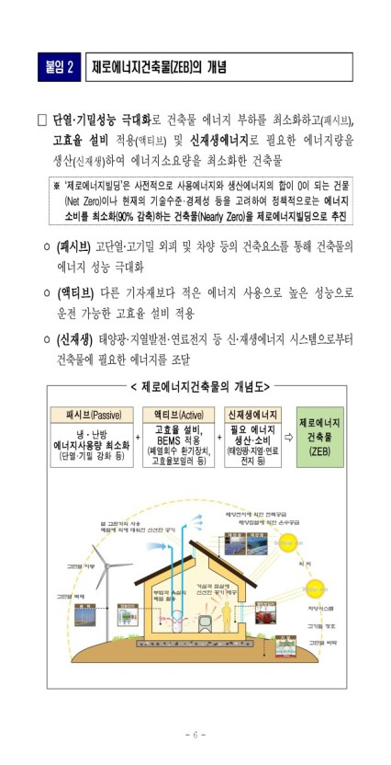
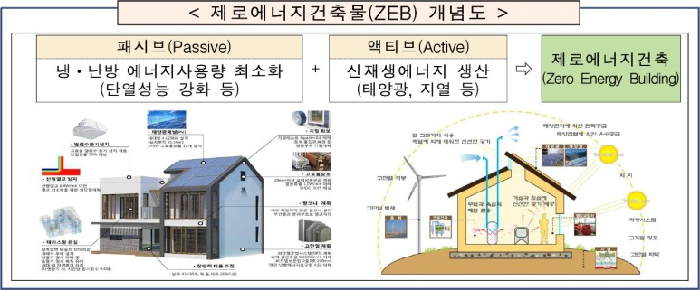
Introduction
What is Eco-friendly and Zero Energy Building?
The Meaning of Green Buildings in Recent Architecture: Zero Energy Buildings
A green planted building
It should provide comfort for the convenient life of the occupants,
It should use less energy.
It is even better if it uses no energy (zero energy) or positive energy (produces energy).
A building in which the production and consumption of energy are the same is called a zero-energy building.
Amendments to the Rules for Building Energy Efficiency Rating Certification and Zero Energy Building Certification (Ministry of Land, Infrastructure and Transport April 29, 2021)

Slide 5
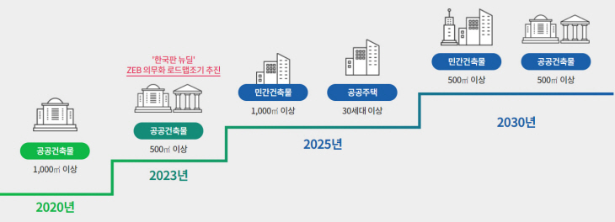
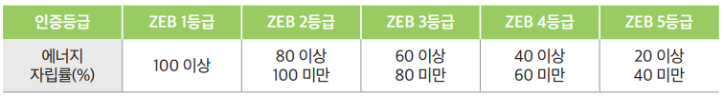
Introduction
What is Eco-friendly and ZEB(Zero Energy Building)?
ZEB Implementation Roadmap
There are still difficulties in implementing a ZEB in its entirety.
Burden of building owner due to increase in construction cost
Technical problems due to insufficient development of related technologies
Social consensus of members is required for the realization of a ZEB
Therefore, Korea is promoting a zero-energy roadmap for all buildings in the private and public sectors in 2030 by phase.
In addition, different certifications are given for each zero-energy grade according to the energy self-sufficient rate.

Slide 6
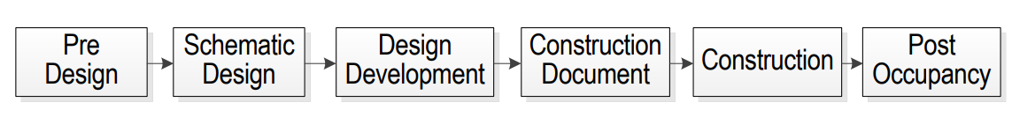
Low/Zero Energy Building Planning
Conventional building design process
In the existing building design process, the following factors were emphasized:
Example for composing the mass of a building
Building design
Building program and room layout
Color or texture of building components
Design focuses on the form and function of the building in the basic design stage.

Slide 7
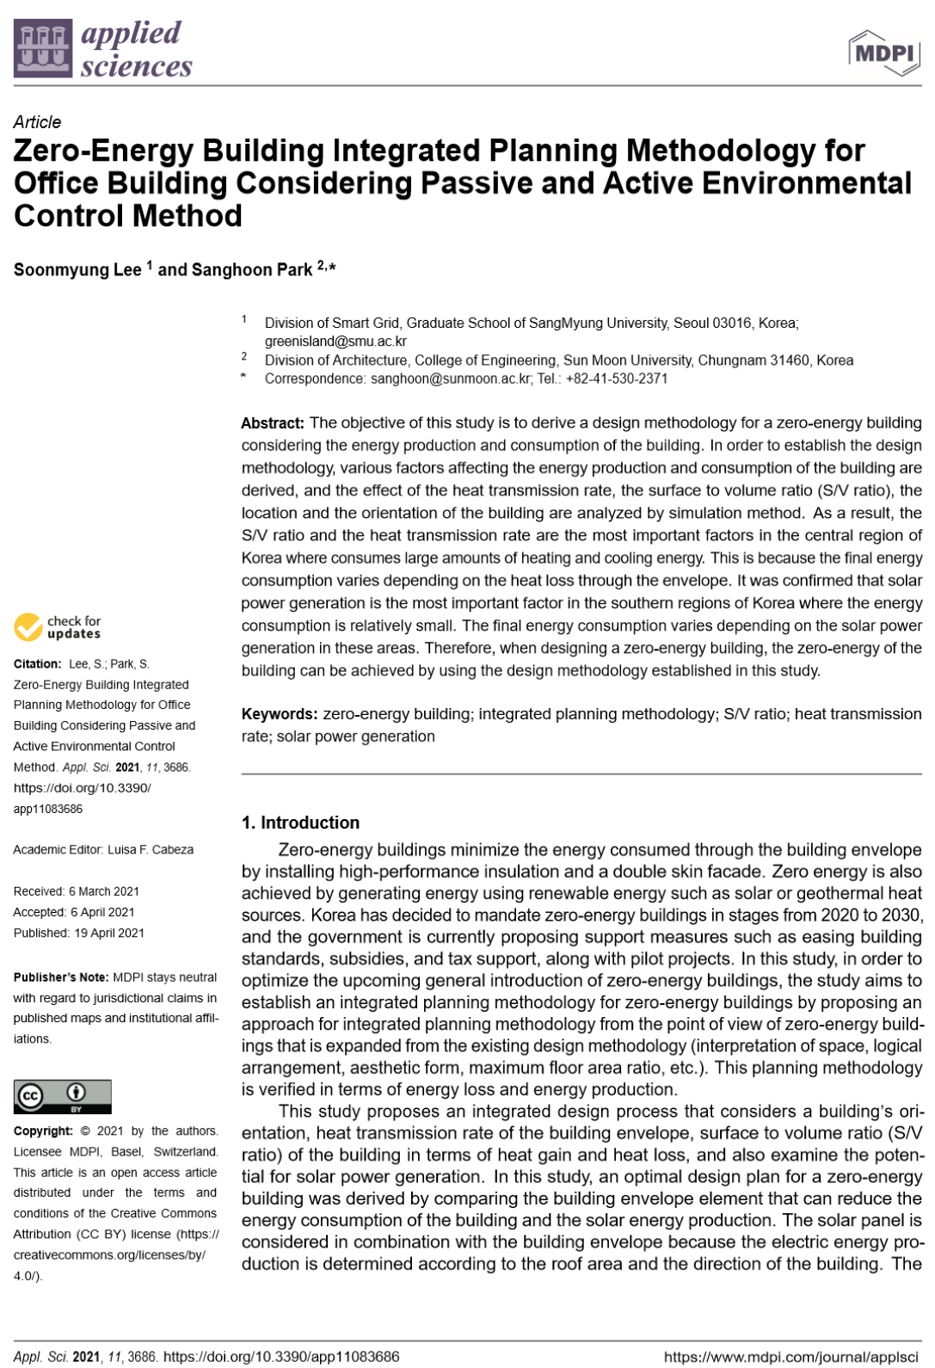
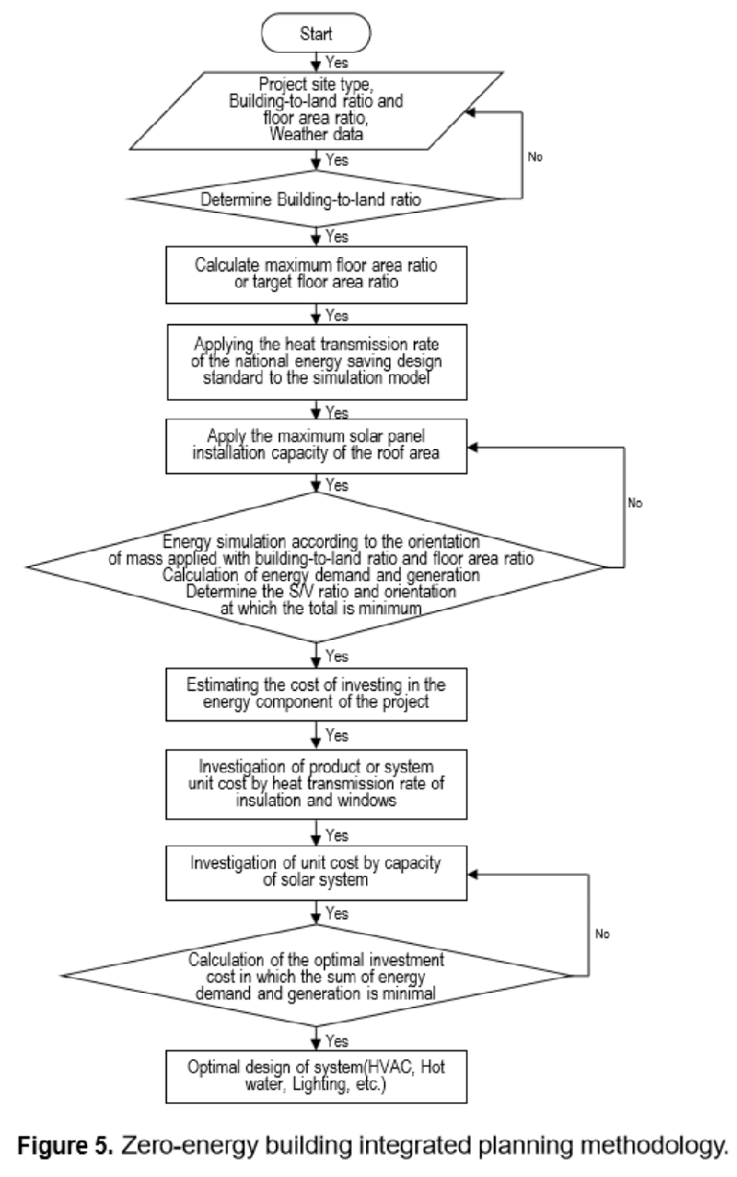
Low/Zero Energy Building Planning
ZEB planning and design process
Recent building planning processes focus on the following factors:
Example for composing the mass of a building
Orientation of the building
Arrangement of windows and openings
S/V ratio of the building
Passive elements
Active elements

Slide 8
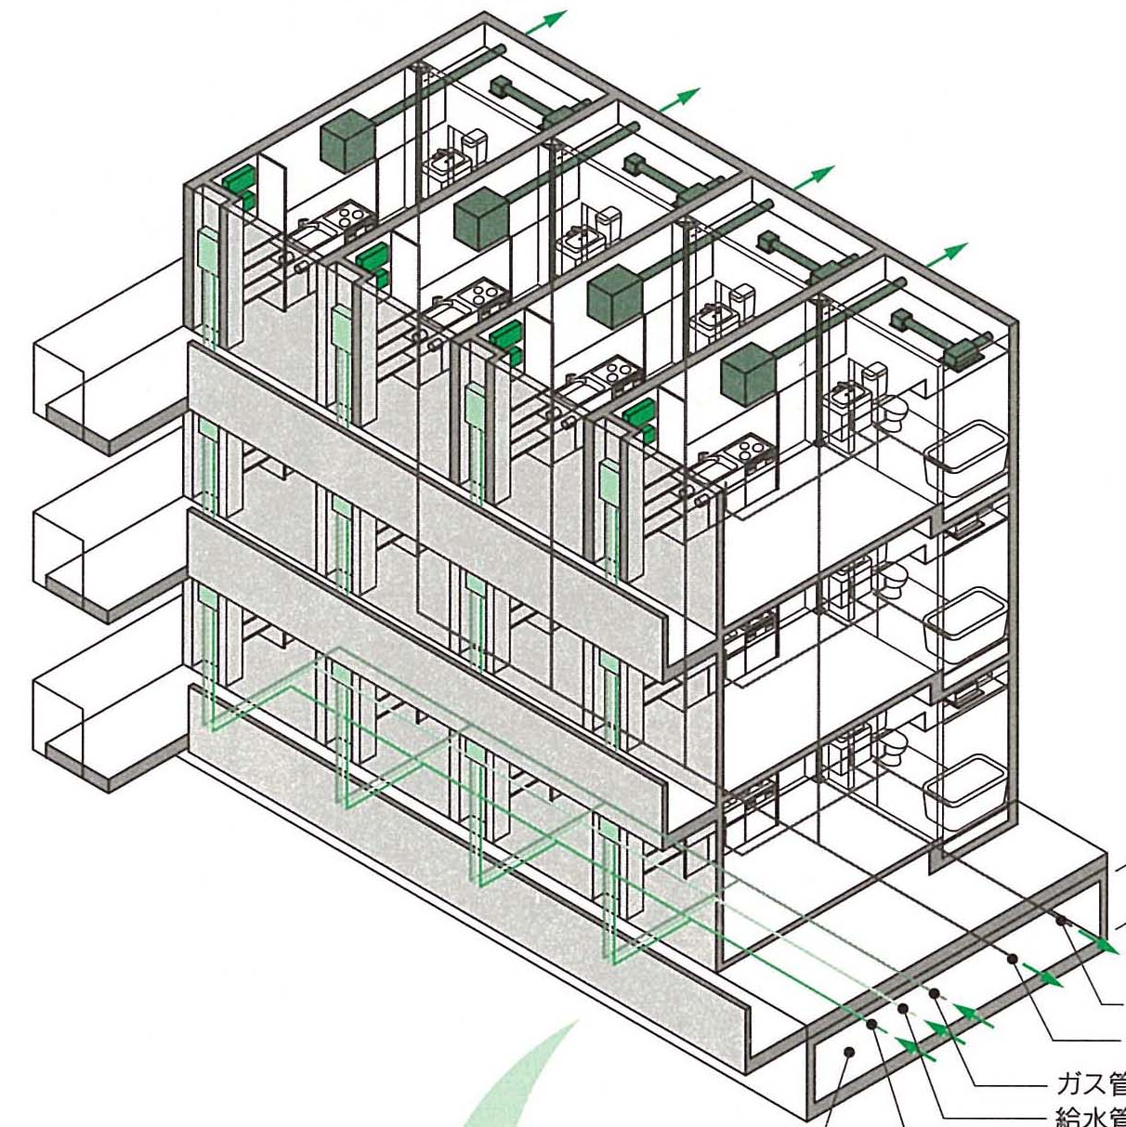
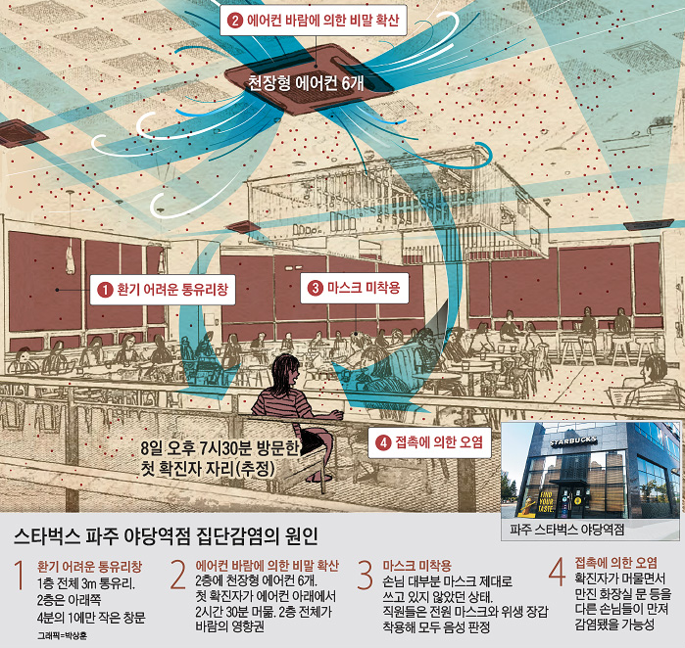
ZEB Technology
Passive? or Active?
The passive and active systems of a building are the organs, nerves, and blood flow of a person
Comfort: temperature, humidity, illuminance (brightness), IAQ(Indoor Air Quality*
* In particular, due to the recent COVID-19 pandemic, the importance of the air environment has been highlighted.
Convenience: (water) water supply, sewage + (rainwater) drainage + (electricity, radio wave, Internet) + gas, broadcasting antenna, telephone, etc.
Safety: Firefighting, Fire Extinguishing

Slide 9
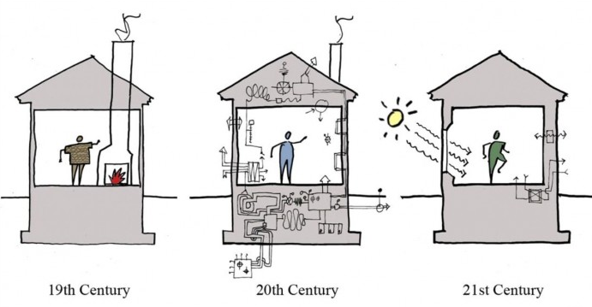
ZEB Technology
Passive? or Active?
What technology will you use to implement ZEB?
Precautions when applying passive and active technologies to buildings
Building too irresponsible due to lack of technological advancement
Over-equipped buildings (prioritize energy performance over comfort)
A building with the right balance between passive and active technology (conserving energy while achieving comfort)

Slide 10
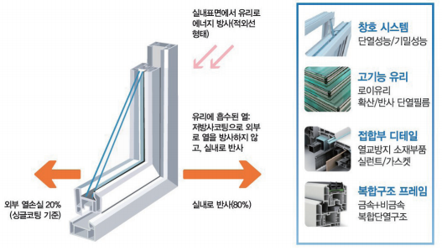
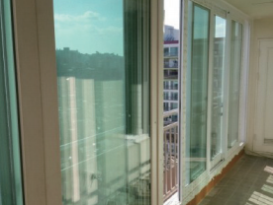
ZEB Technology
PASSIVE environmental building control technology
Technology to save energy using architectural design
Natural ventilation: A technology that designs the passage of wind, which is natural energy, and induces the exchange of indoor air with outdoor air by utilizing the difference in air pressure.
Natural light: A technology that utilizes sunlight to take over the role of lighting and reduce the use of unnecessary lighting
Green Roof: A technology to plant plants on the roof of a building to block heat from sunlight (in summer) or absorb heat emitted (in winter).
High performance windows:
Because the windows are made of glass, the inflow of solar radiation is greater and the inflow of air is easier than the walls with insulation materials.
Block the inflow of air by using multiple layers of glass (triple window), or apply a special coating (Low emissivity coating) to the glass to block the ingress of solar radiation.
There is an effect of saving about 10% or more of heating and cooling energy

Slide 11
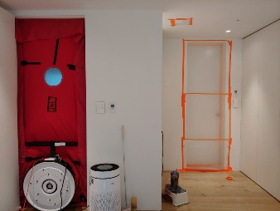
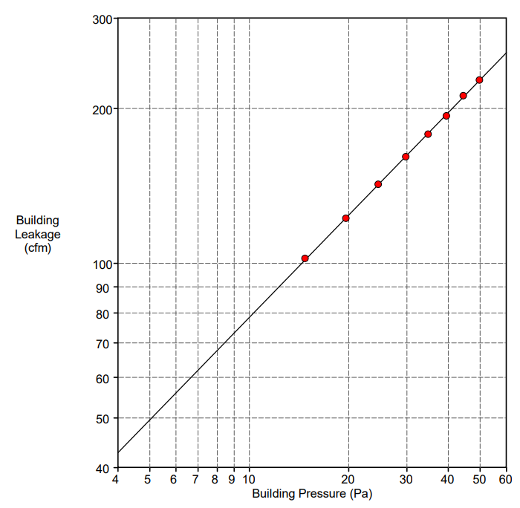
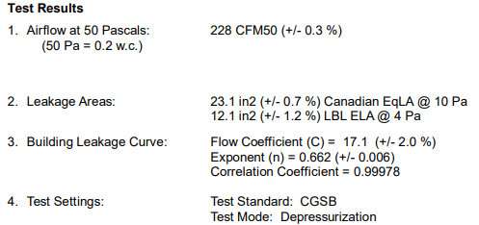
ZEB Technology
High performance air-tightness:
Technology that blocks the penetration of outside air or the escape of indoor air by minimizing the gap that occurs when a window or door is closed or the gap that heat escapes from the window and wall.
It is possible to keep the indoor temperature and reduce heating energy consumption by blocking the heat from escaping through the gap, and it is possible to prevent the occurrence of mold due to moisture.
Measure the airtightness and infiltration (leakage) area, and the airtight supplementation construction should be carried out in the relevant area.

Slide 12
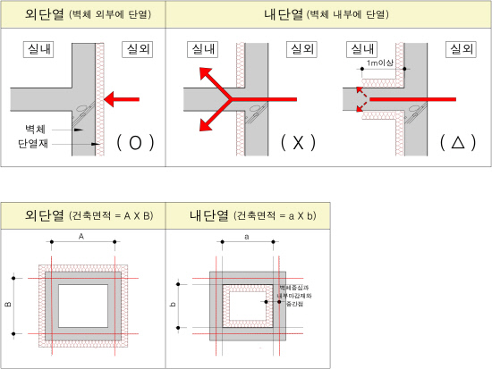
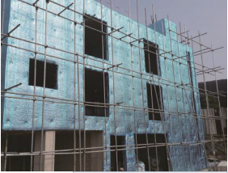
ZEB Technology
External insulation:
Blocking the movement of heat indoors and outdoors is called insulation, and insulation is installed on the walls of buildings to reduce heat loss.
Insulation materials are divided into internal insulation, middle insulation, and exterior insulation according to the location where they are installed.
External insulation refers to a method of installing an insulating material on the outside of a building structure so that the insulating material surrounds the building.
Compared to other thermal insulation methods, the thermal insulation effect is excellent, and the thermal bridge phenomenon is small.
Exterior insulation is the method that can store and utilize the most indoor heat in the structure, and it is a core technology of zero-energy buildings because it maintains the indoor temperature by absorbing or releasing the heat stored in the structure slowly over time.

Slide 13
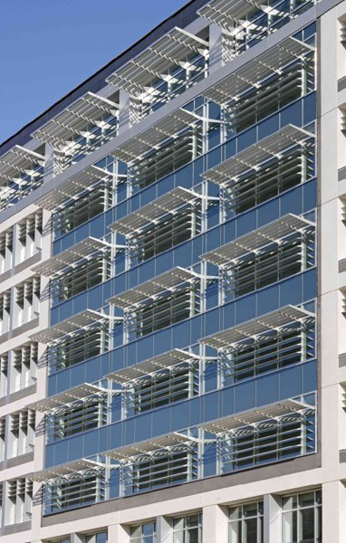
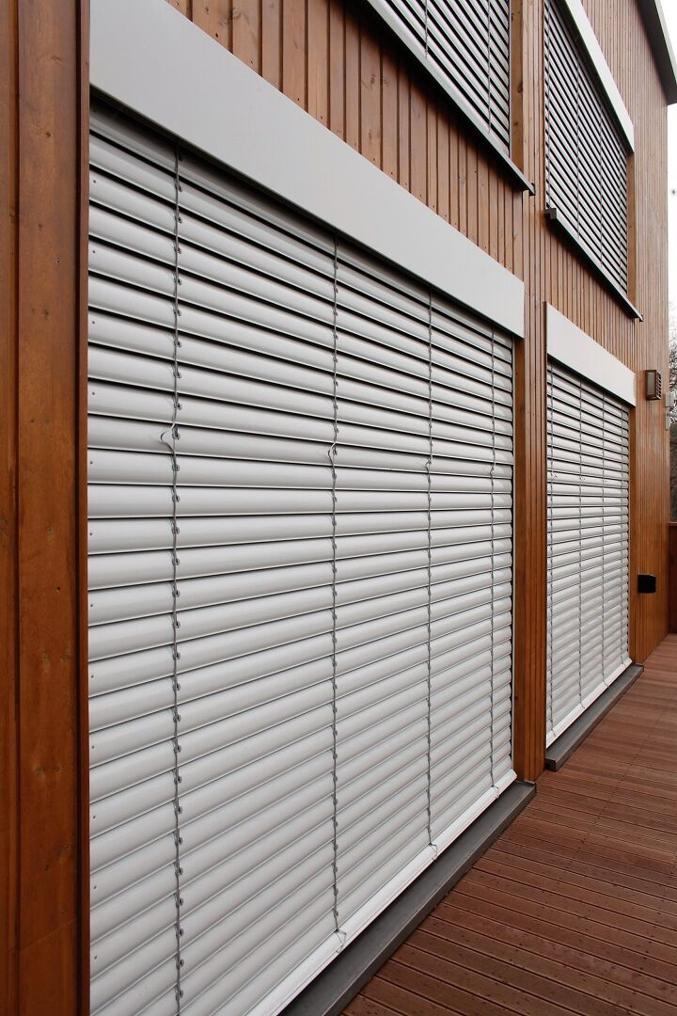
ZEB Technology
External Blind:
Exterior awning refers to a technology that blocks sunlight entering the room using eaves or blinds installed in buildings.
It is effective to plan the awning outside rather than inside, as the sunlight, which has a lot of heat, must be blocked before it enters the room.5~15% of cooling energy can be saved by using external awning.
Considering the purpose and orientation of the building, it is necessary to establish an appropriate shading plan to reduce unnecessary energy consumption of the building and create a pleasant thermal environment.
In the case of a building facing south, if only the cooling load is considered, a fixed horizontal awning should be planned, and an external awning larger than the window width should be installed to block direct sunlight from the southeast and southwest. Considering all heating and cooling loads, variable awnings should be planned.
In the case of a building facing east and west, it is difficult to block sunlight with a protruding awning unlike south facing, so the windows should be planned to a minimum and the sun should be blocked by adjusting the angle of the vertical awning pin.

Slide 14
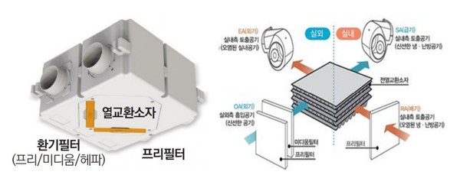
ZEB Technology
ACTIVE environmental building control technology
Technology to achieve comfort in buildings using power
High-efficiency boiler: A technology that uses a high-efficiency boiler while simultaneously serving both indoor heating and hot water supply to save heating energy, which accounts for more than 1/3 of the total energy used at home.
High-efficiency LED lighting: The power used by LED lighting is 1/5 of that of general lighting, and its lifespan is 15 times longer, so it is excellent in terms of energy and resource saving.
Fuel cell: A technology that directly produces electrical energy through a chemical reaction between hydrogen and oxygen
Heat Recovery Ventilation(HRV):
A device that raises the temperature of the air supplied to the room through heat exchange between the cold air coming in from the outside and the hot air discharged from the room to the outside.
A method of exchanging heat without directly mixing indoor polluted air and outdoor fresh air.
Since the outside air that has passed through the waste heat recovery ventilation system is heated to a certain temperature through heat exchange and supplied to the room, it is possible to save heating energy due to the use of a boiler or other heating device.

Slide 15
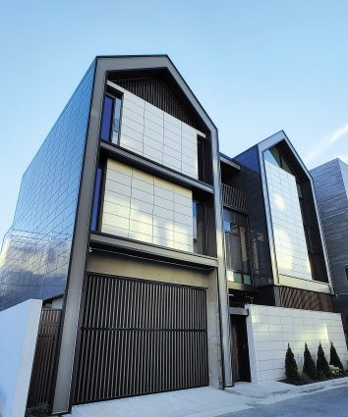
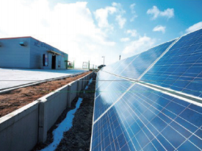
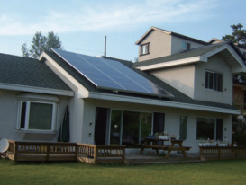
ZEB Technology
Solar power generation(Photovoltaic):
Solar power generation is a power generation technology that produces electricity by converting light energy from the sun.
Because it uses solar energy, which is natural energy, the energy source is infinite, has a long lifespan, and has the advantages of easy maintenance.
There is a difference in power generation efficiency depending on the installation angle of the photovoltaic panel (solar cell), so a photovoltaic power generation installation plan that can absorb sunlight most effectively is required.
In addition to the existing installation method of installing on the ground, a building-integrated photovoltaic system (BIPV), which combines a photovoltaic power generation system with the exterior wall material of a building, is being used.

Slide 16
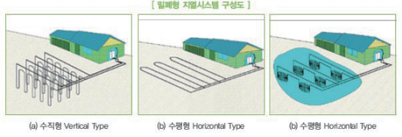
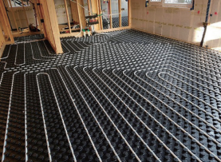
ZEB Technology
New & Renewable energy
Technology that optimizes energy independence by using renewable energy
Geothermal heating and cooling devices:
The underground length of 100~150m maintains a constant temperature of about 15°C regardless of the outside temperature, so the ground is cooler than the ground in summer and warmer than the ground in winter.
The principle of geothermal energy is to use the seasonal temperature difference, which is lower than the ground in summer and higher than the ground in winter.
By installing an underground heat exchanger, heat stored in the ground is transferred to the building in winter, and heat is taken from the building in summer and sent into the ground.

Slide 17
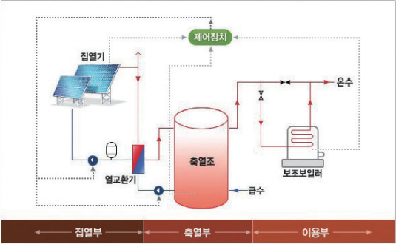
ZEB Technology
Solar cooling and heating devices:
Technology that absorbs energy as heat and uses it as energy.
If you heat water using solar heat, you can get hot water for heating or hot water supply without using gas or electricity, and it has the advantage of no noise and no pollution.
Solar thermal energy has a low energy density and varies greatly by season and time, so heat collection and storage technology are the most basic technologies.

Slide 18
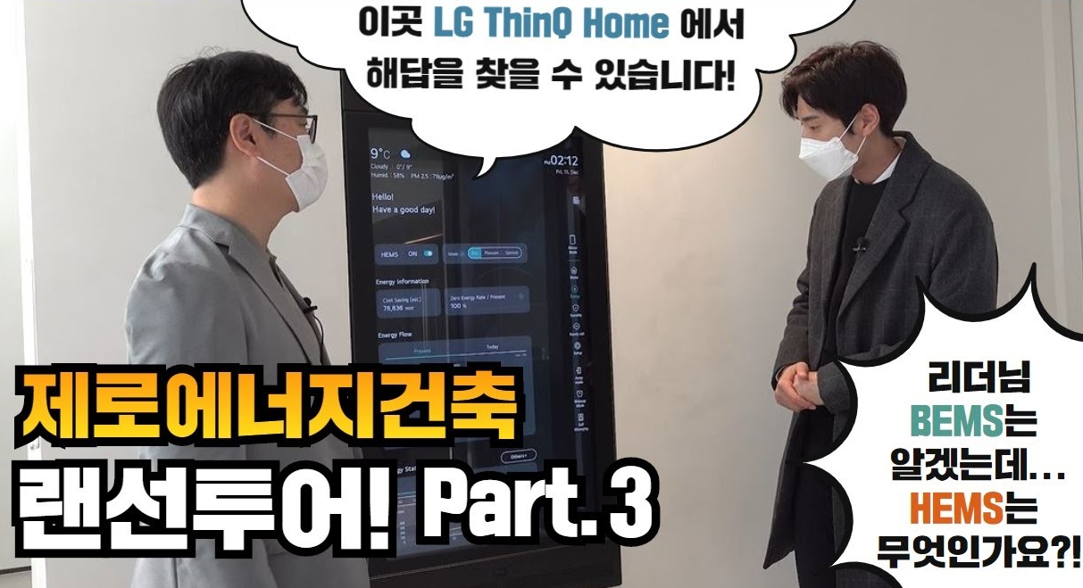
ZEB Technology
BEMS(Building Energy Management System)
Technology to improve energy management efficiency by optimizing energy production and consumption
BEMS(Building Energy Management System):
BEMS refers to an integrated system of measurement, control, management, operation, etc. that provides an optimized building energy management plan by monitoring energy usage for the maintenance of a comfortable indoor environment and efficient energy management.
BEMS can be divided into three main functions.
The first function is to measure the energy consumption in a building in real time and notify the user.
The second function is to analyze the energy consumption in each building, and through this, it is possible to find the optimal point of energy cost and energy use by comprehensively analyzing the efficiency of each facility in the building and the indoor and outdoor environment.
Finally, through the facility control function, the building energy can be optimally managed by controlling the measured-analyzed contents in connection with the energy-using facility.

Slide 19

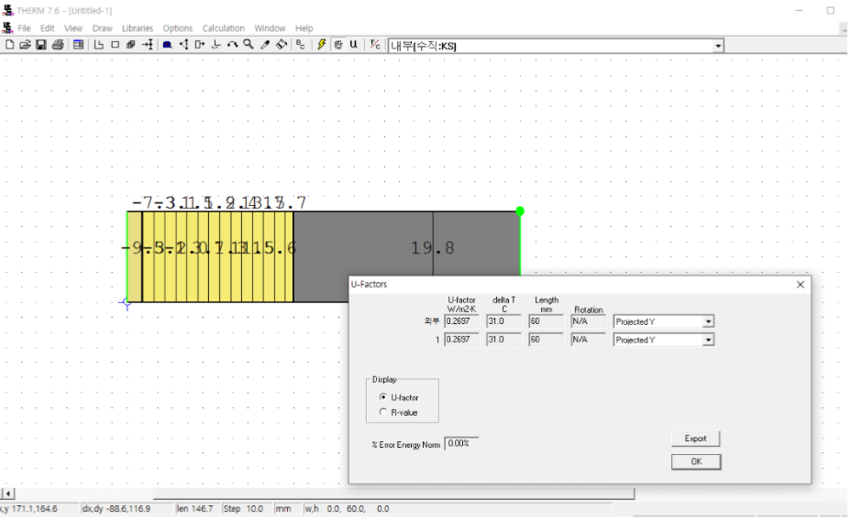
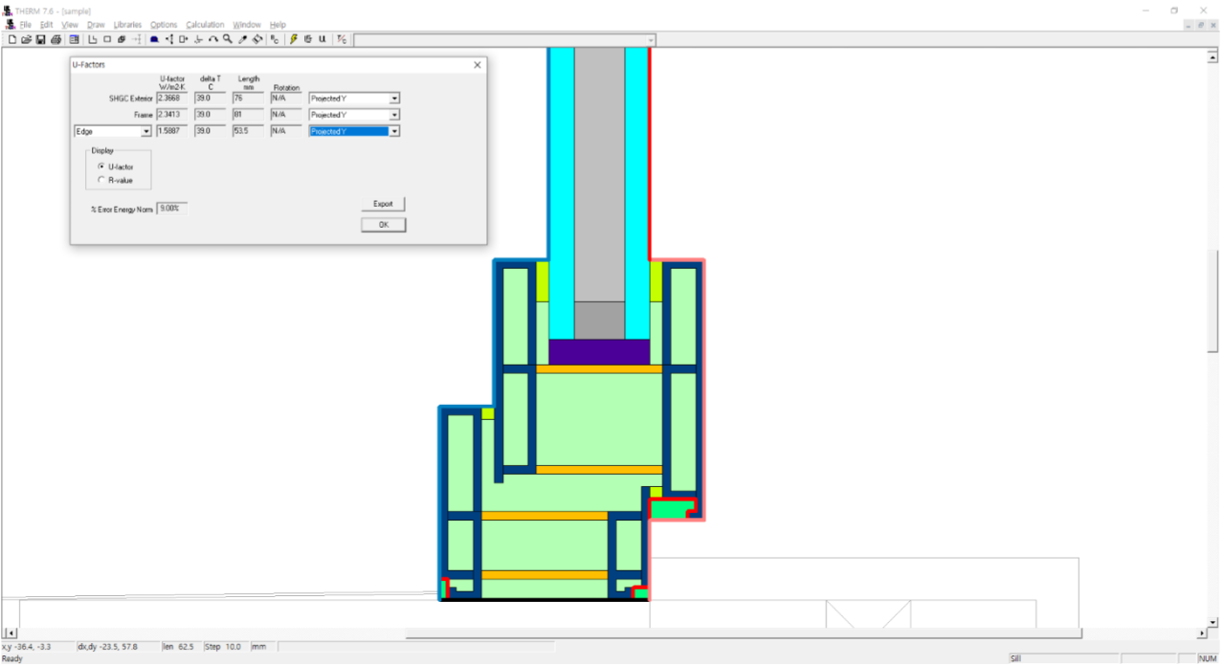
Simplified Building Simulation Method for ZEB
Window and Wall simulation
Why use simulation program in buildings?
to save time and cost
to get quick results
Example of simulation of windows and walls: LBNL Window + THERM

Slide 20
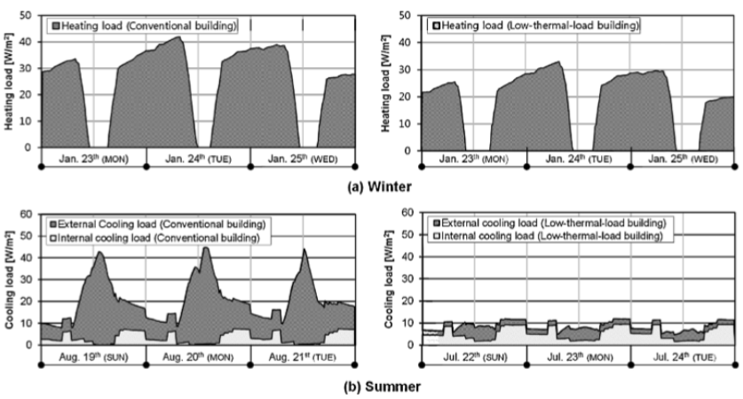
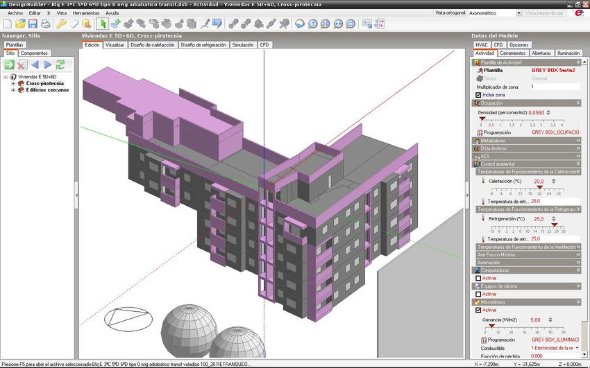
Simplified Building Simulation Method for ZEB
Building energy simulation
Building energy simulation programs: Energy#, PHPP, EnergyPlus, DesignBuilder etc.
Utilization of Building Simulation
1) Calculation of absolute value of energy savings
2) Comparative evaluation of energy saving rate: Calculate the relative saving rate for reference building

Slide 21
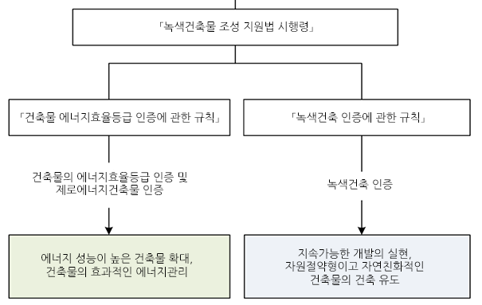
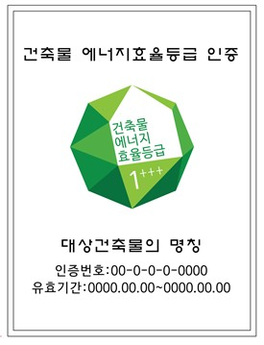
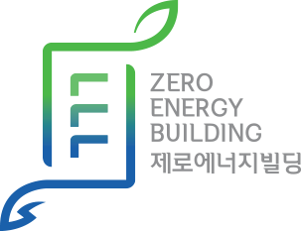

Building Code and Certification for ZEB
Green Building Certification in Korea
「Enforcement Regulations of the Green Building Creation Support Act」 (2020.12.11)
The purpose is to set standards for energy-saving design such as heat loss prevention for efficient energy management of buildings, standards for writing energy-saving plans and design reviews, and matters related to relaxation of building standards to revitalize the construction of green buildings
※ Incentive
Support for new/renewable energy installation subsidies, reduction of the contribution rate for infrastructure donations, relaxation of building standards such as floor area ratio and height of buildings by up to 15%, reduction of acquisition tax by up to 15%, increase of loan limit by 20% for the Housing and Urban Fund, etc.

Slide 22
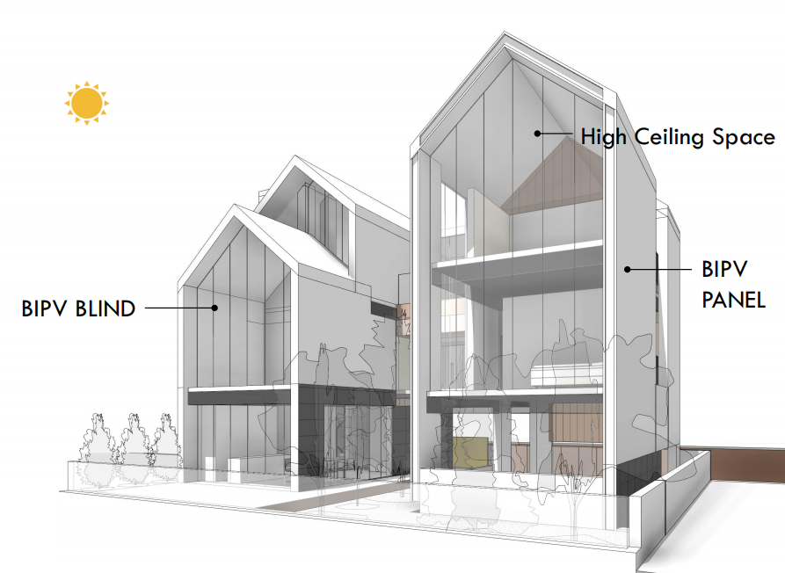
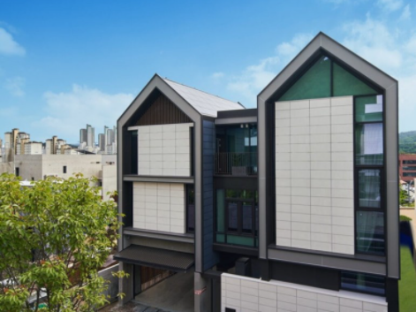

Case study
LG ThinQ home (Pankyo, South Korea)
The first residential building to obtain first-class in ZEB certification in Korea
Achieved about 120% energy self-sufficient ratio
Representative technology
BIPV(Building Integrated PhotoVoltaic), BEMS(Building Energy Management System), On-Demand, Two-way electric vehicle charging, etc.
※ First unveiled at IFA2020
Search 'LG ThinQ home IFA' on YouTube

Slide 23
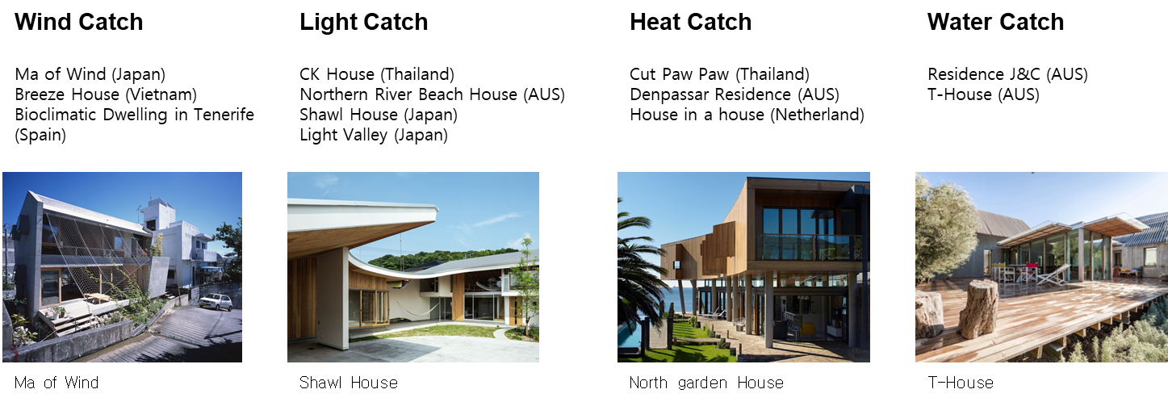
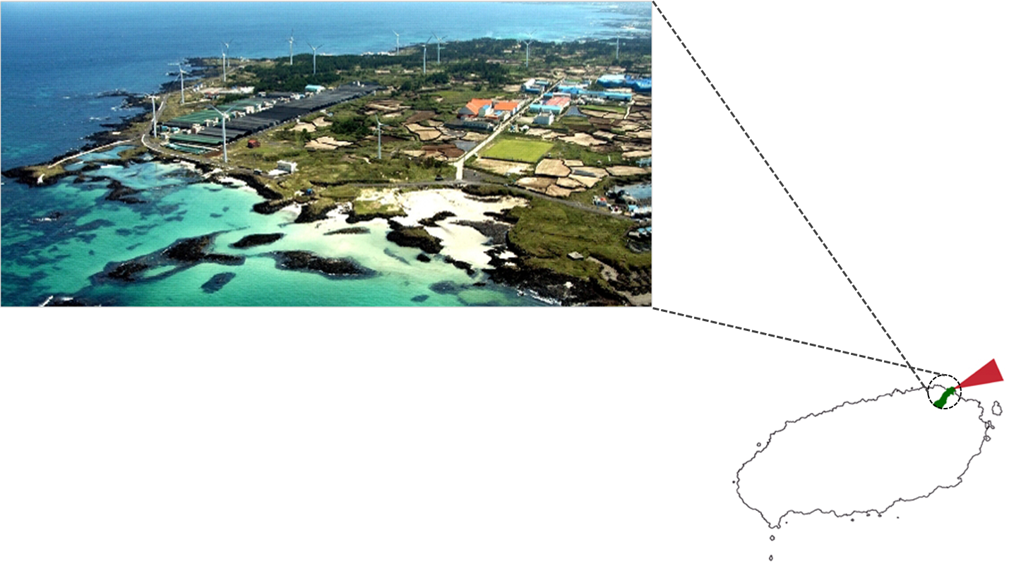
Case study
The residence in Jeju (Jeju, South Korea)
Designed with the goal of realizing a ZEB using Jeju's natural environment

Slide 24
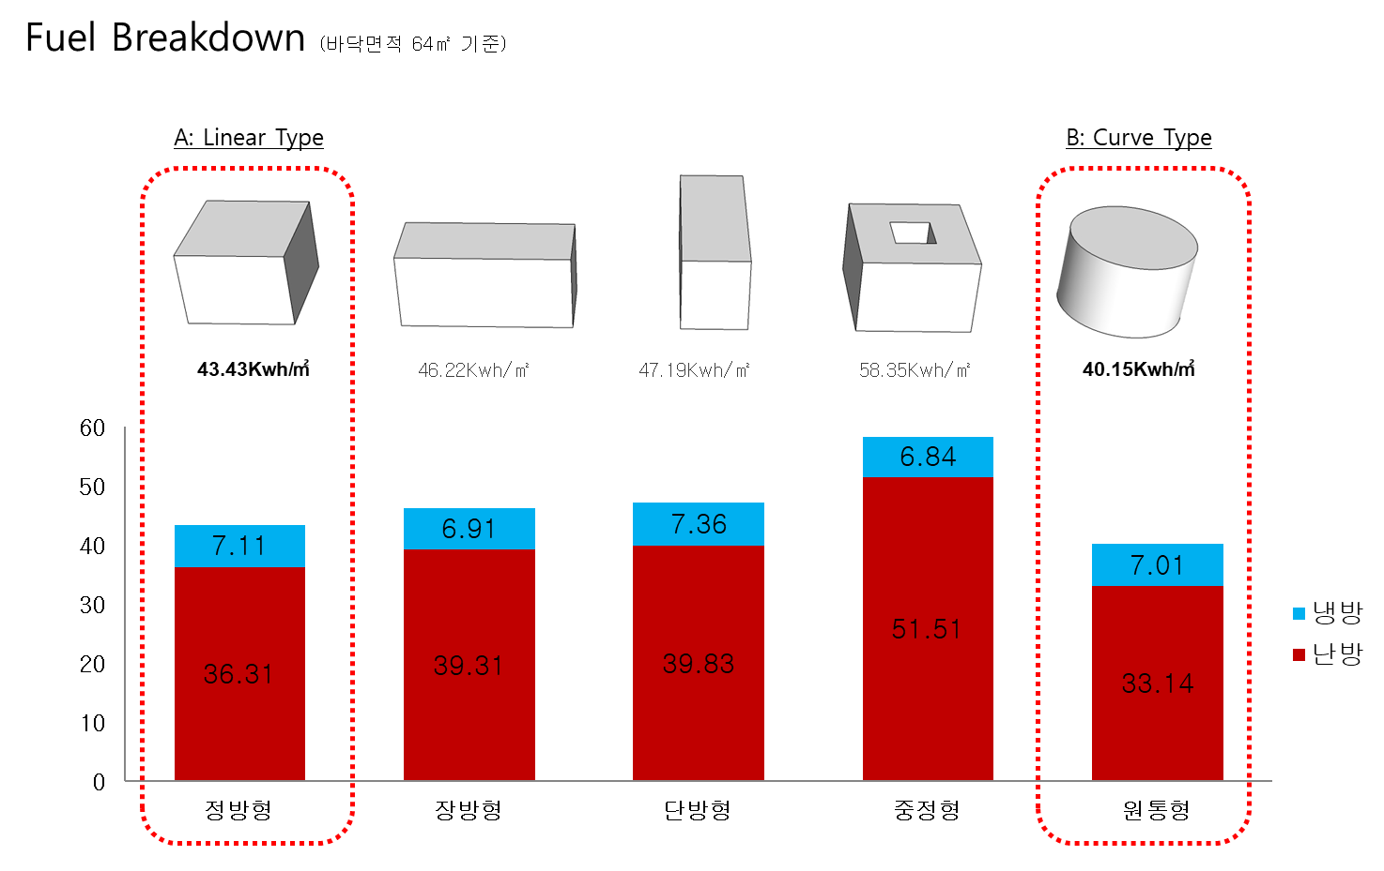
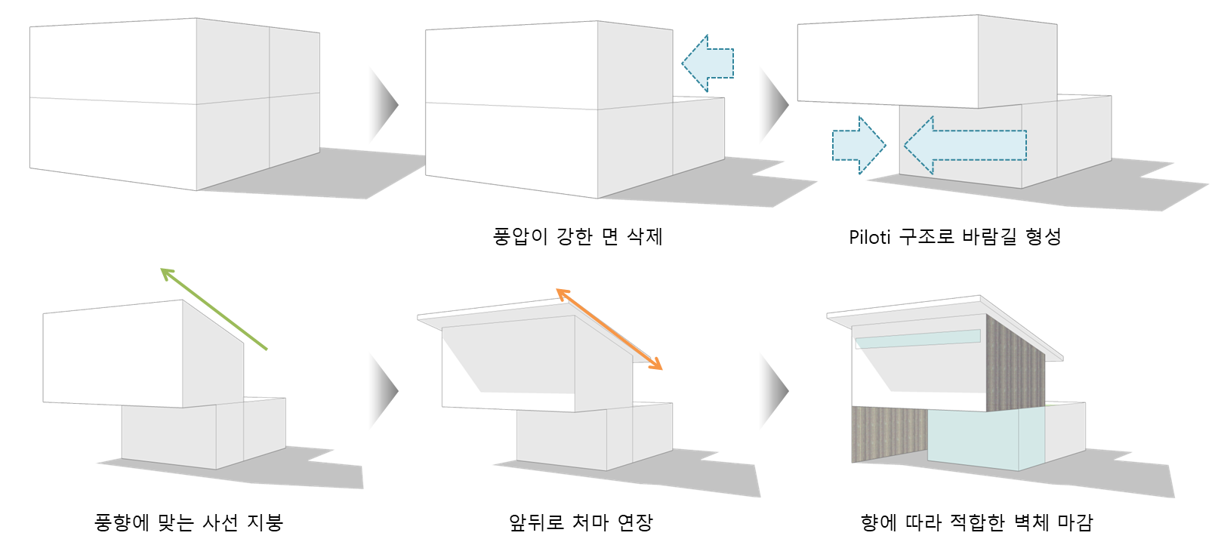
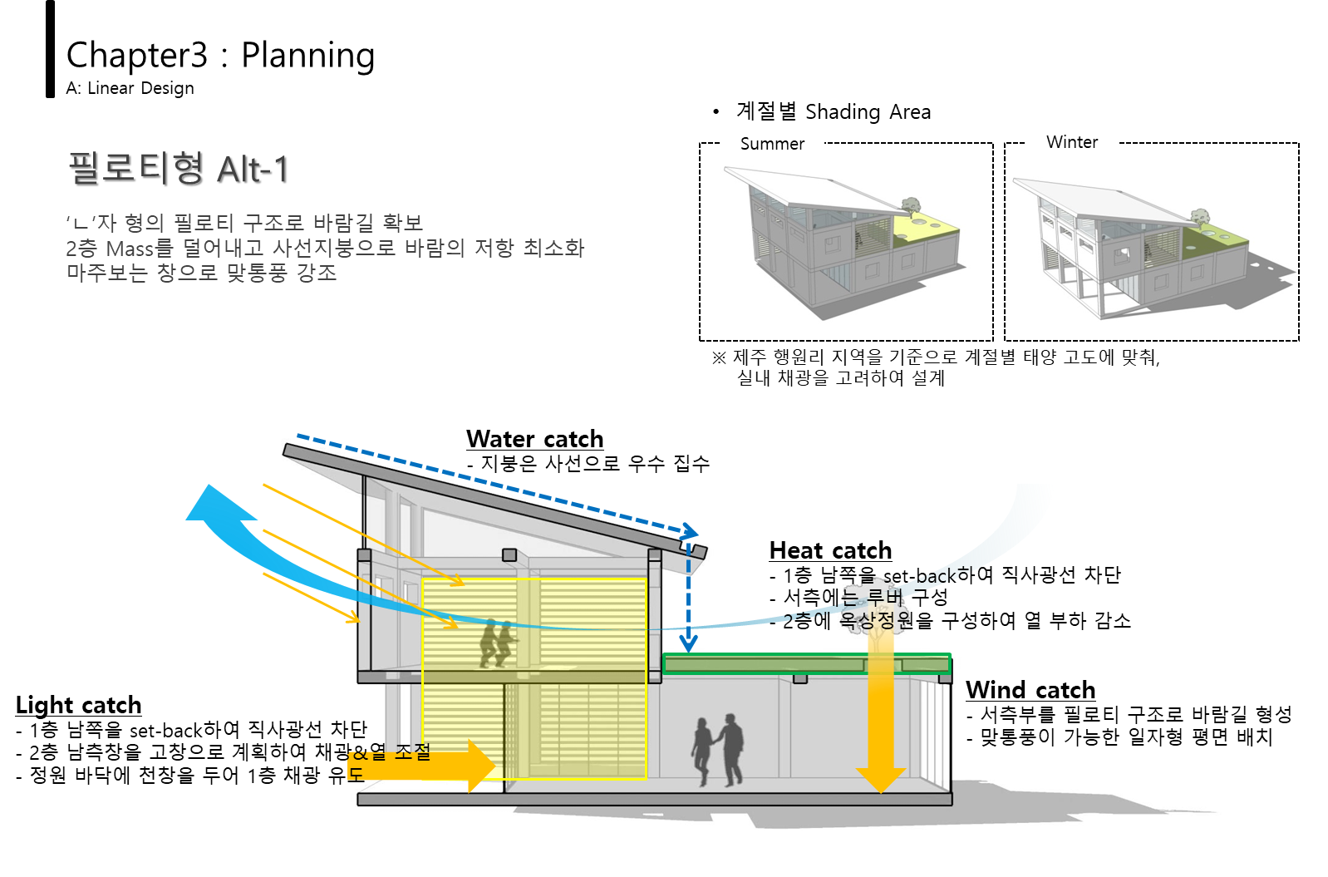
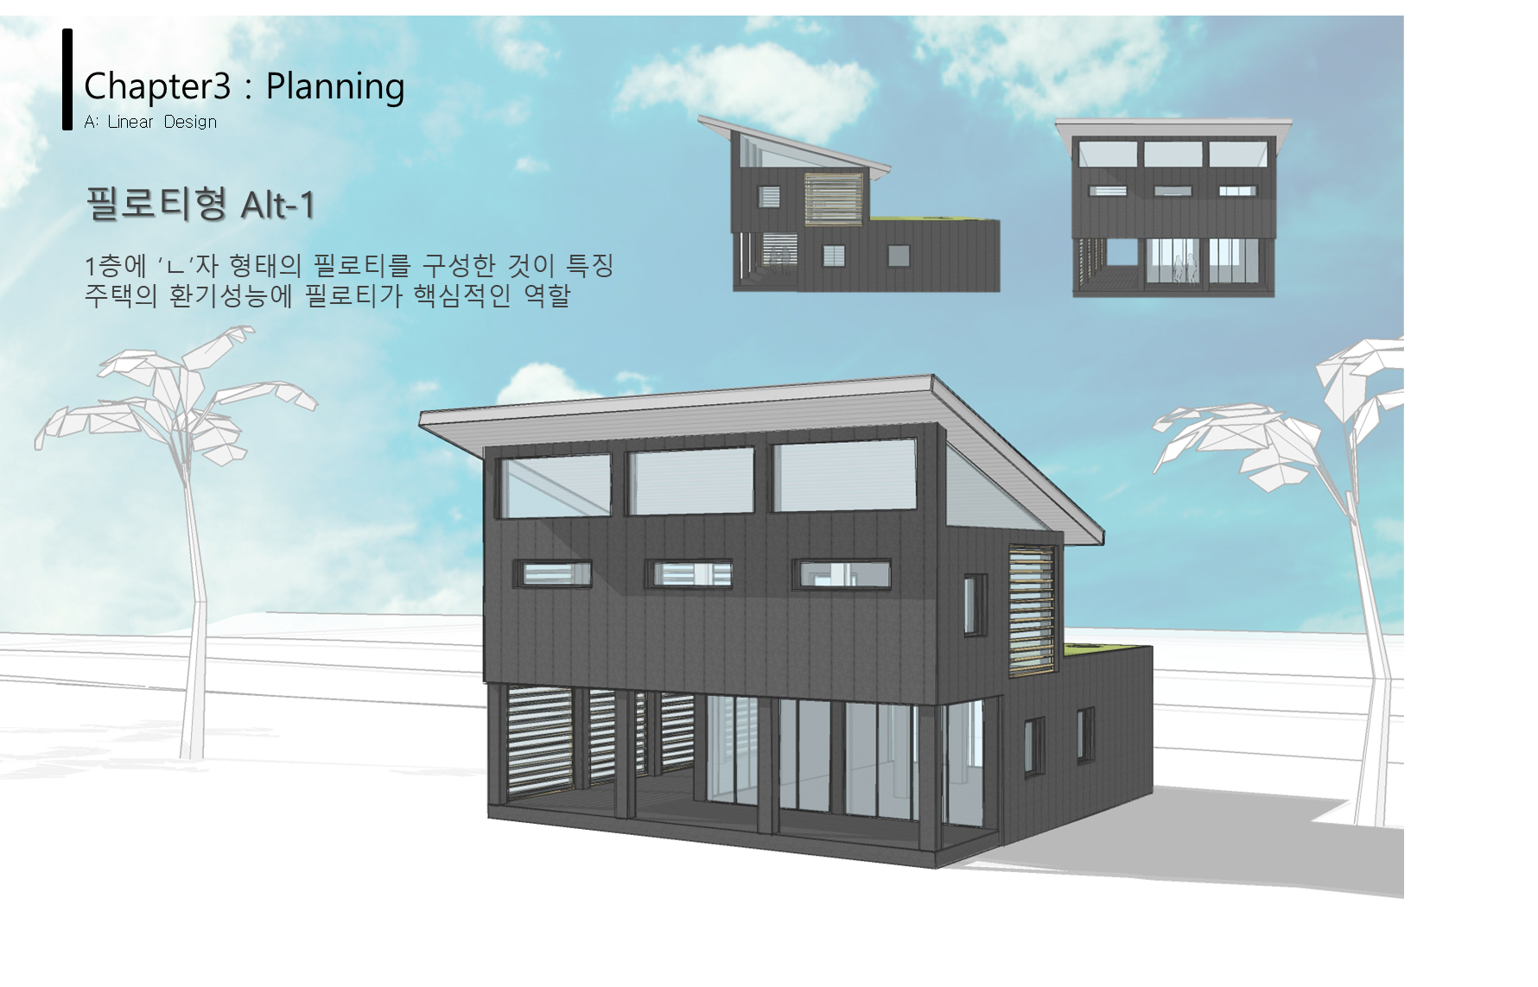
Case study
The residence in Jeju (Jeju, South Korea)
Designed with the goal of realizing a ZEB using Jeju's natural environment

Slide 25
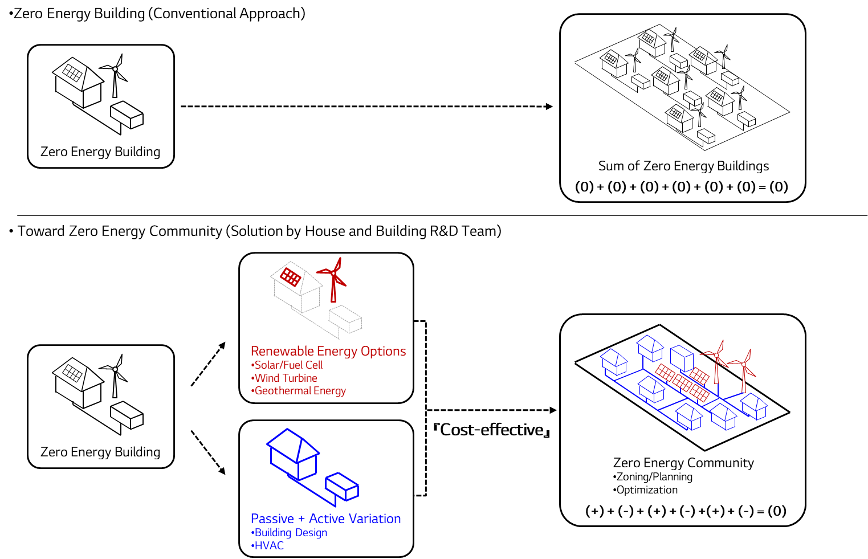
Future issues
Beyond individual ZEB: Zero Energy City
Energy Self-sufficient City
In the case where zero energy cannot be implemented in the building itself due to the limitations of the building, a zero-energy city can be implemented in the community or city.

